Slide 1

Social change and population health
David Leon
London School of Hygiene & Tropical Medicine
david.leon@lshtm.ac.uk
Tackling Population Health Challenges, University of Southampton
12 June 2014

Slide 2
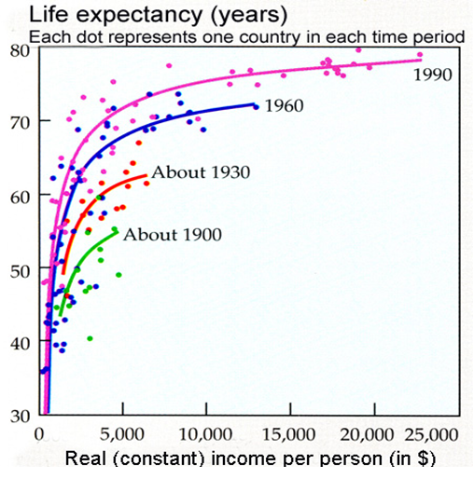
Preston curves
S. H. Preston. Pop Stud, Vol. 29, 1975; Reprinted Int.J.Epidemiol 36 (3):484-490, 2007

Slide 3
Preston curve
Global diffusion of knowledge
and its application
S. H. Preston. Pop Stud, Vol. 29, 1975; Reprinted Int.J.Epidemiol 36 (3):484-490, 2007

Slide 4
International trends in life expectancy at birth

Slide 5
Life-expectancy at birth (years) by country 1950-2012
Males
Females
Notes:
Whereas most industrialised countries have undergone improvements in life-expectancy, Russia has seen stagnation or even reversals.
Comment on large F-M diff for Russia – reached a peak of 13 years in 1994.

Slide 6
Japan

Slide 7
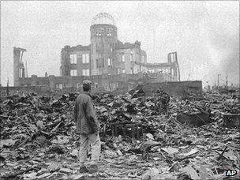
Japan’s starting point 1945

Slide 8
Post-war Japan
Tradition of strong commitment to health improvement
Minimal diversion of resources into military
Development of strong economy
Rapid urbanisation
Very late adoption of smoking
Capacity to adopt and adapt new technologies from vanguard countries in all spheres (industry and health care)

Slide 9
Western Europe

Slide 10
Trends in European life expectancy 1970-2009
Belgium, Denmark, Finland, France, Germany, Ireland, Italy, Netherlands, Norway, Portugal, Spain, Sweden, UK

Slide 11
Trends in European life expectancy 1970-2009
Consistent upward trends
Belgium, Denmark, Finland, France, Germany, Ireland, Italy, Netherlands, Norway, Portugal, Spain, Sweden, UK

Slide 12
Trends in European life expectancy 1970-2009
..... despite obesity epidemic
Belgium, Denmark, Finland, France, Germany, Ireland, Italy, Netherlands, Norway, Portugal, Spain, Sweden, UK

Slide 13
Post-war communist Europe

Slide 14
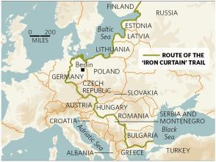

Slide 15
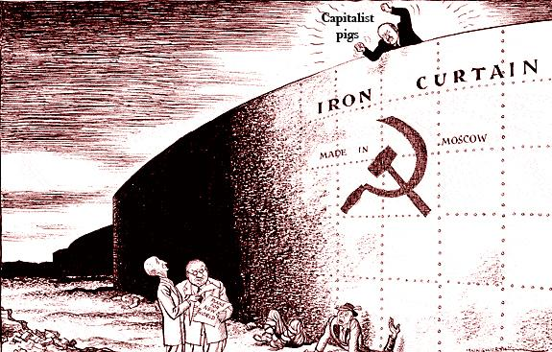

Slide 16
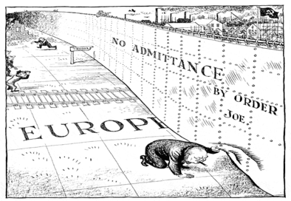
Major barrier to diffusion of new knowledge

Slide 17
Post-war communist Europe
Public health function remained with pre-war focus on infectious disease
Low level expenditure on health care and health technology
High expenditure on military investment
Population health improvement not central political priority
Cultural, scientific and technological isolation (especially in biomedicine)

Slide 18
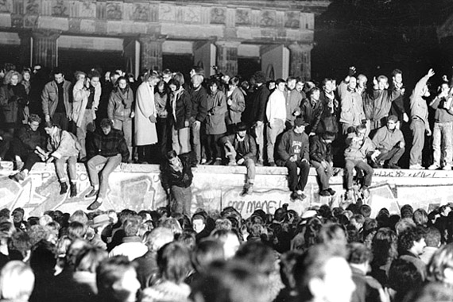
Fall of the Berlin Wall 1989

Slide 19
Fall of the Berlin Wall 1989
Extraordinary natural experiment

Slide 20
Trends in European life expectancy 1970-2009
Hungary, Poland, Czech Republic, Slovakia

Slide 21
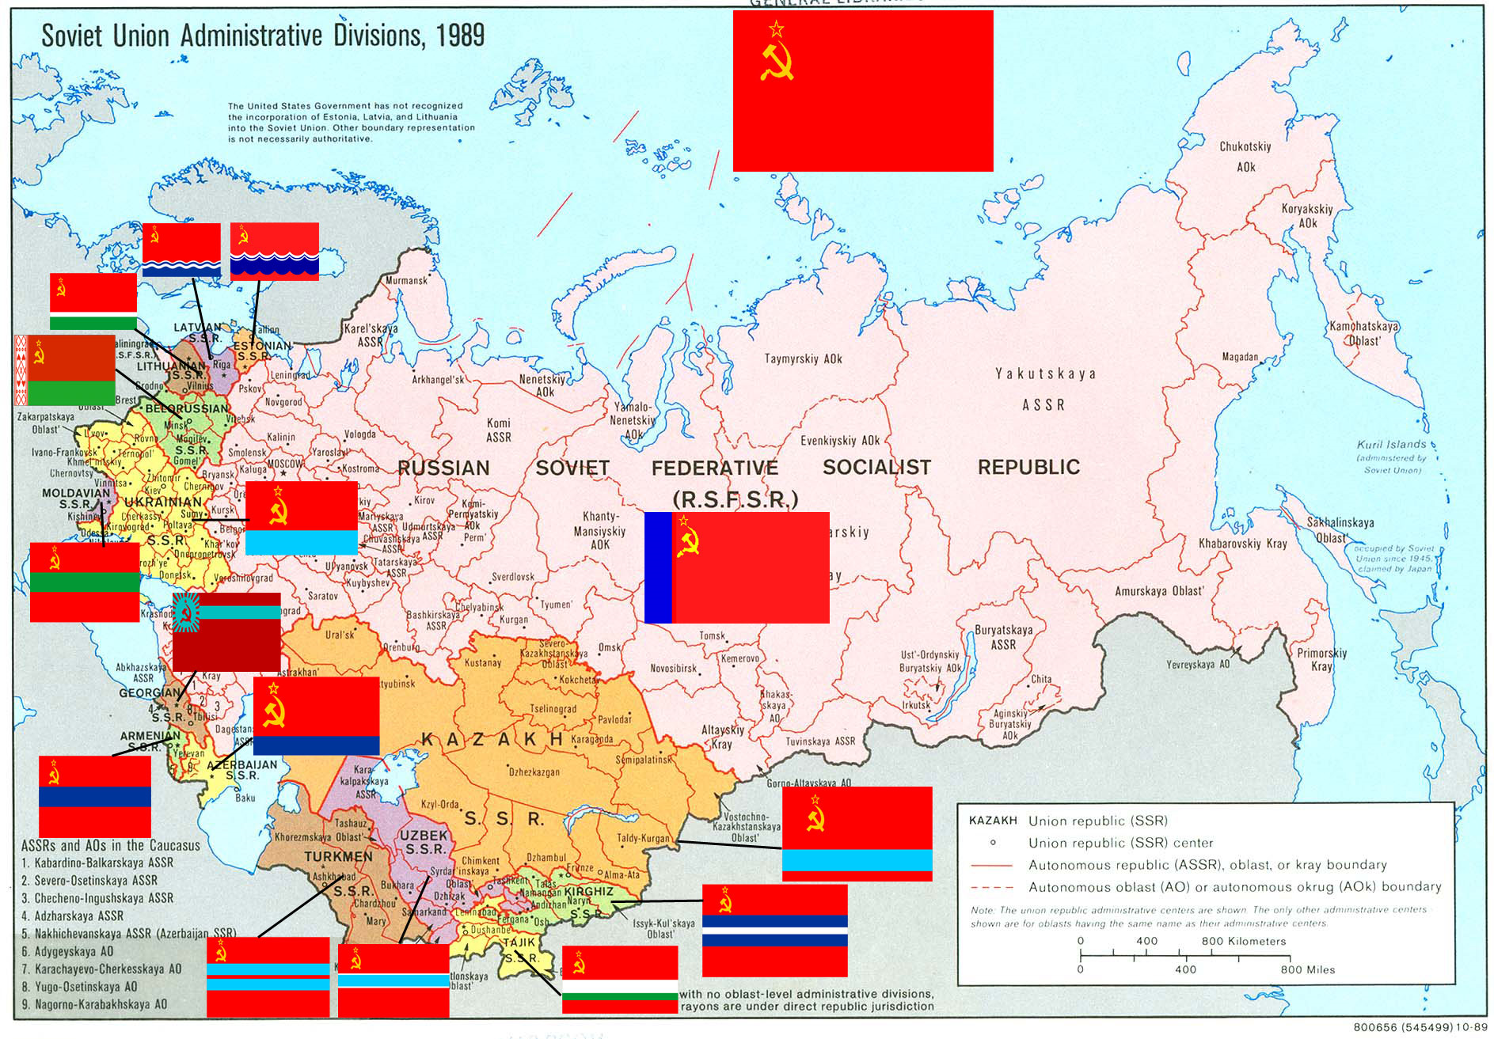

Slide 22
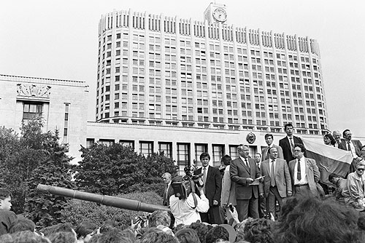
Collapse of Soviet Union 1991

Slide 23
Trends in European life expectancy 1970-2009
Estonia, Latvia, Lithuania

Slide 24
Possible reasons for improvement in Eastern Europe
Change in attitudes to health (at level of individual and the state)
Dietary change
Alcohol and tobacco control strategies
Improvements in access to effective primary and secondary prevention

Slide 25
Trends in European life expectancy 1970-2009
Russia

Slide 26
Russia

Slide 27
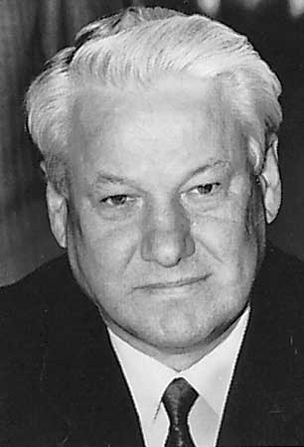
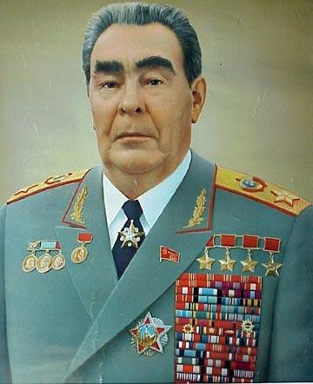


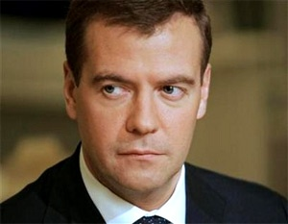
Major changes in Russian society ….
Brehznev 1977-85
“Era of stagnation”
Yelstin 1991-99
Putin 1999-2008
Putin 2012-
Medvedev
2008-12
Gorbachev 1985-91
“Perestroika” and “Glasnost”
Notes:
Perstroika = restructuring
Glasnost = “publicity” opposite of “silence” or “taboo”
1994 Shannon Airport – being unwell

Slide 28
Life expectancy at birth 1955 - 2010
EU members
(pre-2005)
Russia

Slide 29
Life expectancy at birth 1955 - 2010
Russia 64 (2011)
UK 79 (2011)
Russia 76 (2011)
UK 83 (2011)
Notes:
Ru and Tatarstan from Evgueny Andreev. UK and Norway from GBD

Slide 30
Life expectancy at birth 1955 - 2010
EU members
(pre-2005)
Russia
Gorbachev
anti-alcohol campaign
Gorbachev
anti-alcohol campaign

Slide 31

Life expectancy at birth 1955 - 2010
EU members
(pre-2005)
Russia
Gorbachev
anti-alcohol campaign
Gorbachev
anti-alcohol campaign

Slide 32
Life expectancy at birth 1955 - 2010
EU members
(pre-2005)
Russia
Collapse of Soviet Union
Collapse of Soviet Union

Slide 33
Life expectancy at birth 1955 - 2010
EU members
(pre-2005)
Russia
Collapse of Soviet Union
Collapse of Soviet Union

Slide 34
Life expectancy at birth 1955 - 2010
EU members
(pre-2005)
Russia
Chaos and economic liberalisation
Chaos and economic liberalisation

Slide 35
Life expectancy at birth 1955 - 2010
EU members
(pre-2005)
Russia
Chaos and economic liberalisation
Chaos and economic liberalisation

Slide 36

Life expectancy at birth 1955 - 2010
EU members
(pre-2005)
Russia
Chaos and economic liberalisation
Chaos and economic liberalisation

Slide 37
Life expectancy at birth 1955 - 2010
EU members
(pre-2005)
Foreign currency crisis
Russia
Foreign currency crisis

Slide 38
Life expectancy at birth 1955 - 2010
EU members
(pre-2005)
Russia
Putin elected
Putin elected

Slide 39
Alcohol a key driver of fluctuations

Slide 40
Strong evidence that alcohol drives fluctuations
in male life expectancy in Russia 1965 -2008
Source : V. Shkolnikov and E. Andreev

Slide 41
Cardiovascular disease in Russia

Slide 42
Source : Data provided by Evgueny Andreev

Slide 43
Challenge to received wisdom that alcohol is cardioprotective
Source : Data provided by Evgueny Andreev

Slide 44
Hazardous drinking and mortality from various types of circulatory disease
Men aged 25-54 years, Izhevsk, 2003 - 5
Underlying cause of death | Number of deaths | Hazardous drinking (proxy report)
 |  | OR* | (95% CI)
Alcoholic cardiomyopathy | 98 | 15.70 | (9.5,25.94)
Other cardiomyopathy | 51 | 3.84 | (2.05,7.18)
Cerebrovascular disease | 90 | 2.05 | (1.24,3.40)
Other circulatory disease | 28 | 3.43 | (1.51,7.81)
Ischaemic heart disease | 219 | 3.04 | (2.17,4.24)
* OR adjusted for age, smoking and education
Source : Leon, Shkolnikov, McKee, Kiryanov, Andreev, IJE, 2010

Slide 45
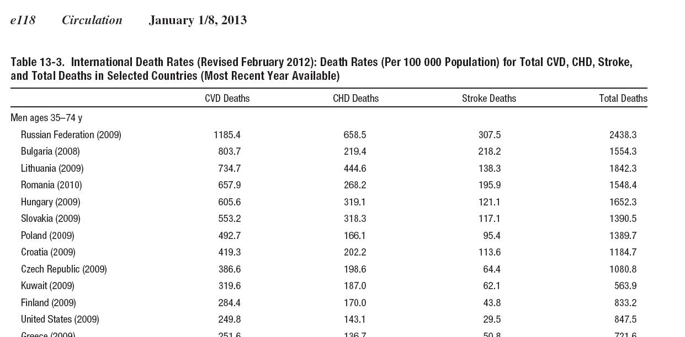
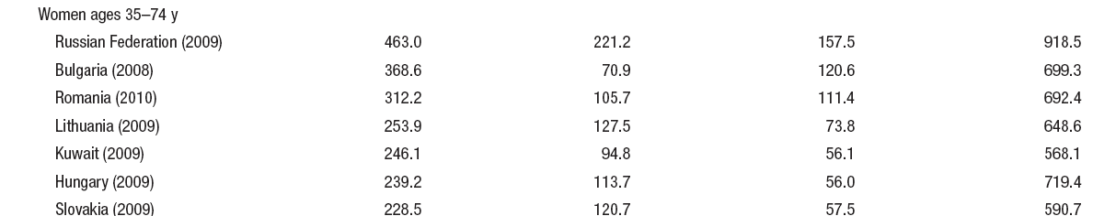
Russia highest out of all 33 countries
for men and women

Slide 46
Cardiovascular disease makes a major
contribution to Russia’s low life expectancy
Life expectancy at birth (years) in 2009
 | Men | Women
United Kingdom | 78.1 | 82.3
Russian Federation | 62.7 | 74.7
Difference (UK minus Russia) | 15.4 | 7.6
Contribution of CVD to difference | 7.5 | 6.3
Contribution of IHD to difference | 4.0 | 3.2
Notes:
Cardiovascular disease accounts for 49% of life expectancy difference between UK and Russia and 83% for women

Slide 47
Recent trends

Slide 48
Cardiovascular mortality trends 1965-2011 by sex
Cerebrovascular disease
Ischaemic heart disease
males
Age-standardised rates per 1000
males
females
females
Source : Shkolnikov

Slide 49
Cardiovascular mortality trends 1965-2011 in males by country
Cerebrovascular disease
Ischaemic heart disease
Age-standardised rates per 1000
Russia
Russia
UK
UK
Norway
Norway
Source : Shkolnikov & WHO HFA

Slide 50
Cardiovascular mortality trends 1965-2011 in females by country
Cerebrovascular disease
Ischaemic heart disease
Age-standardised rates per 1000
Russia
Russia
UK
UK
Norway
Norway
Source : Shkolnikov & WHO HFA

Slide 51
Its not just alcohol ...
Smoking in men
Availability of primary and secondary prevention approaches and technologies
  Statins under-utilised
  Very poor control hypertension
  Low levels revascularisation procedures
Access to and organisation of good standard medical care
  Screening programmes but poor follow-up
  Continuity of care following hospitalisation
  Inadequate level expertise in primary care

Slide 52
A new project : 2014-2019

Slide 53








Cardiovascular disease in Russia: strengthening evidence about causes, mechanisms, prevention and treatment
Institute of Internal Medicine
SBRAMS, Novosibirsk, Russia
Finland
Max Planck Institute for Demographic Research

Slide 54
Sex differences in life expectancy

Slide 55
Life expectancy at birth (years) in 191 countries, 2004
Japan
Lithuania
UK
Russia
China
India
Female life expectancy at birth
Ghana
Kenya
Zimbabwe
Male life expectancy at birth

Slide 56
Life expectancy at birth (years) in 191 countries, 2004
Japan
Lithuania
UK
Russia
China
India
Female life expectancy at birth
LINE OF EQUALITY
Ghana
Kenya
Zimbabwe
Male life expectancy at birth

Slide 57
Life expectancy at birth (years) in 191 countries, 2004
Japan
Lithuania
UK
Russia
China
India
Rise of individual life-style risk factors
Female life expectancy at birth
LINE OF EQUALITY
Ghana
Kenya
Zimbabwe
Male life expectancy at birth

Slide 58
European experience

Slide 59
Sex differences in European life expectancy 1970-2009
Female – Male e0 (years)
Western Europe

Slide 60
Sex differences in European life expectancy 1970-2009
Female – Male e0 (years)
Czech Republic, Hungary,
Poland, Slovakia

Slide 61
Sex differences in European life expectancy 1970-2009
Female – Male e0 (years)
Estonia, Latvia, Lithuania

Slide 62
Sex differences in European life expectancy 1970-2009
Female – Male e0 (years)
Russia

Slide 63
Sex differences in life expectancy
European countries vary dramatically in the extent of gender differences in behaviour (health-related and other)
Western Europe showing decline in differences
Convergence in behaviours in Western Europe
  eg decline in smoking in men, stability or increase in smoking in women
Differences in Eastern Europe persist despite improvements in mortality in many countries

Slide 64
Conclusions
Communism and its collapse in Europe illustrates the profound influence of the “social” on health
Diffusion of knowledge and best practice in health care and public health central across borders crucial for population health
Rapidity of improvements a cause for optimism
Russian experience vivid warning that things can go badly wrong
The willingness and ability of governments to prioritise improvements in health care and public health critical
International variation in sex-differences in mortality underlines importance of (less tractable) cultural factors in determining health

Slide 65
Thank you

Slide 66
Increase in life-expectancy at birth
England and Wales 1841-2009
Years
Gain 1901-1951
F = 22 years
M = 20 years
Female
Male
Gain 1841-1901
F = 6 years
M = 4 years
Gain 1951-2000
F = 10 years
M = 10 years
Source : Government Actuary Department and Human Mortality Database
Notes:
But these increases in life-expectancy seen in the nineteenth century have been nothing compared to what occurred during the twentieth century.
What we can also see is the way in which life-expectancy difference between men and women increased in the period from 1950. Male to female difference in life-expectancy over the 20th Century which rose from 4 years in 1900 to a peak of just over 6 years in the late 1960s.

